Slide 1

Analysis of DataCo Supply Chain
Project Proposal
CS 5610 100- Advanced R for Data Science
Designed by
Ponnekanti Karthikeya
Win :- 321233913
Ibrahim khaleelulla Mohammad
Win :- 323002312
Instructor
Dr. Wassnaa AI- Mawee

Slide 2
Agenda
Introduction
Project Objectives
data
Design overview
Reading the data

Slide 3
Introduction
Walmart's supply chain is one of the most efficient and advanced in the world. It is an integrated network of suppliers, manufacturers, warehouses, distribution centers, and stores that work together to ensure a steady flow of goods to Walmart's customers. Walmart’s supply chain involves the acquisition of raw materials, production of products, and delivery of goods to the stores. It also involves the management of inventory and transportation. To ensure that its supply chain runs smoothly, Walmart utilizes a combination of sophisticated technology and advanced analytics to track and optimize its supply chain operations. Walmart also works closely with its suppliers to ensure that it has a steady supply of the products it needs to meet customer demand.

Slide 4

Objectives
1. Identify and implement process improvements that will reduce or eliminate supply chain costs, improve customer service levels, and increase efficiency.
2. Develop strategies to reduce inventory levels, while maintaining customer service levels.
3. Utilize technology to automate and streamline supply chain activities.

Slide 5

Objectives
4. Implement strategies to improve the visibility of the supply chain and reduce the amount of manual work needed to manage the supply chain.
5. Develop strategies to improve the speed of order fulfilment and increase customer satisfaction.
6. Identify and reduce the risks associated with supply chain operations.

Slide 6

Data
The information is all about the Walmart's logistics and supply chain management system is one of the most complex and efficient in the world. It is designed to enable the company to respond quickly to customer demand and maintain a competitive advantage. The system is designed to be agile, leveraging technology to enable the company to efficiently manage its global supply chain, from raw materials to finished products. Walmart leverages its global resources to source materials and products from suppliers around the world, and then distributes them to its thousands of stores in a timely manner. The system is designed to be cost-effective, efficient, and flexible, allowing Walmart to quickly respond to changing customer needs and market trends.

Slide 7

Design Overview
We are planning to use different types of functions ,libraries and visualization methods for DataCo supply chain data sets.
Like apply() , Map() functions ,
for Data wrangling we are using dplyr() And for Data visualization ggplot2 and we are planning to use different type of tools further based on the study and requirement for our data set.

Slide 8
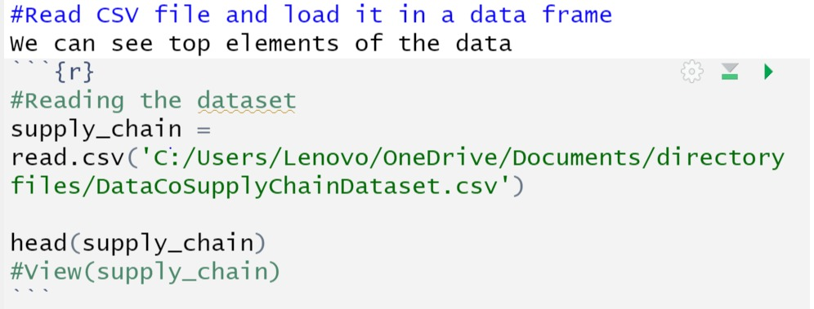
Reading the data

Slide 9
Count mode of transaction
Count mode of transaction in data supply chain is a method of conducting transactions where the buyer and seller agree to count the number of items involved in the transaction, rather than relying on the total dollar amount. This method is often used in data-centric supply chains, where large amounts of data are exchanged between parties. With the count mode of transaction, each item is counted individually and the total number of items is calculated at the end of the transaction. This allows the buyer and seller to quickly and accurately assess the value of the transaction, without having to rely on price estimates or calculations. Count mode of transaction can also be used to simplify the process of tracking the number of items exchanged, as well as the quality and quantity of

Slide 10
Order status
The status of an order in a data co supply chain can be tracked using the R programming language. R can be used to create a program that can track the status of an order from the time it is placed to when it is delivered. This program can be used to monitor the progress of the order and alert the user when there is a delay or problem with the order. The program can also be used to generate reports on the performance of the supply chain, such as the average delivery time and the number of orders that have been delayed. Additionally, the program can be used to track the costs associated with the supply chain, such as the cost of materials, labor, and other overhead costs.

Slide 11
shipping modes,department names and number of orders
Shipping Modes: 1. Ground Shipping 2. Air Shipping 3.
Express Shipping
Courier Services: This is the most expensive shipping mode and is best suited for time-sensitive, small shipments.
Departments:
1. Sales 2. Operations 3. Customer Service
4. Accounting Number of Orders: The number of orders will vary depending on the size and scale of the business.

Slide 12
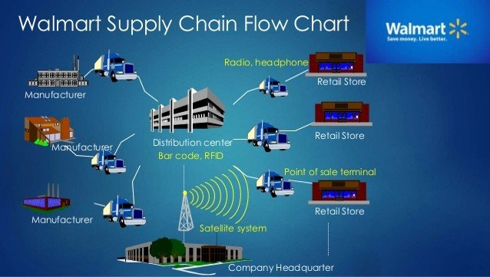
References
https://www.researchgate.net/figure/Walmart-Supply-Chain-Flowchart_fig1_320021998
https://ivypanda.com/essays/supply-chain-management-walmart-stores/

Slide 13
thank you
ponnekantikarthikeya@gmail.com
ibrahimkhaleelulla2727@gmail.com

